Slide 1
Incentive Compatibility of Bitcoin Mining Pool Reward Functions
By:
Okke Schrijvers
Joseph Bonneau
Dan Boneh
Tim Roughgarden
Yoni Asulin

Slide 2
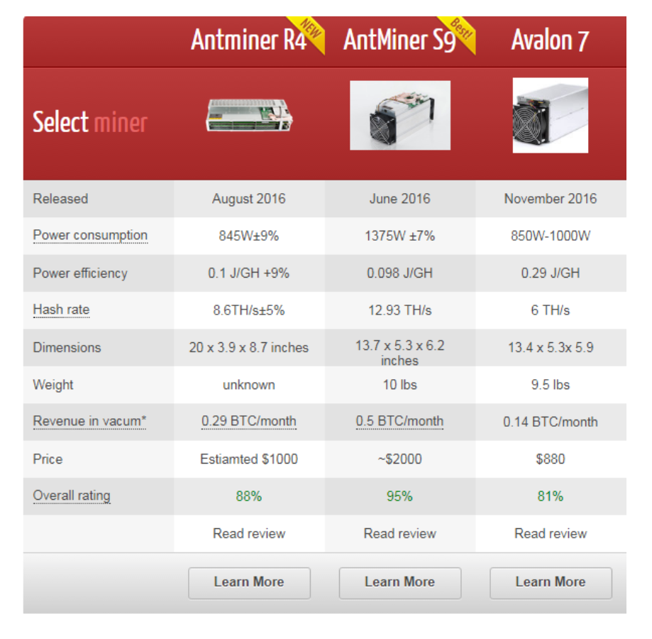
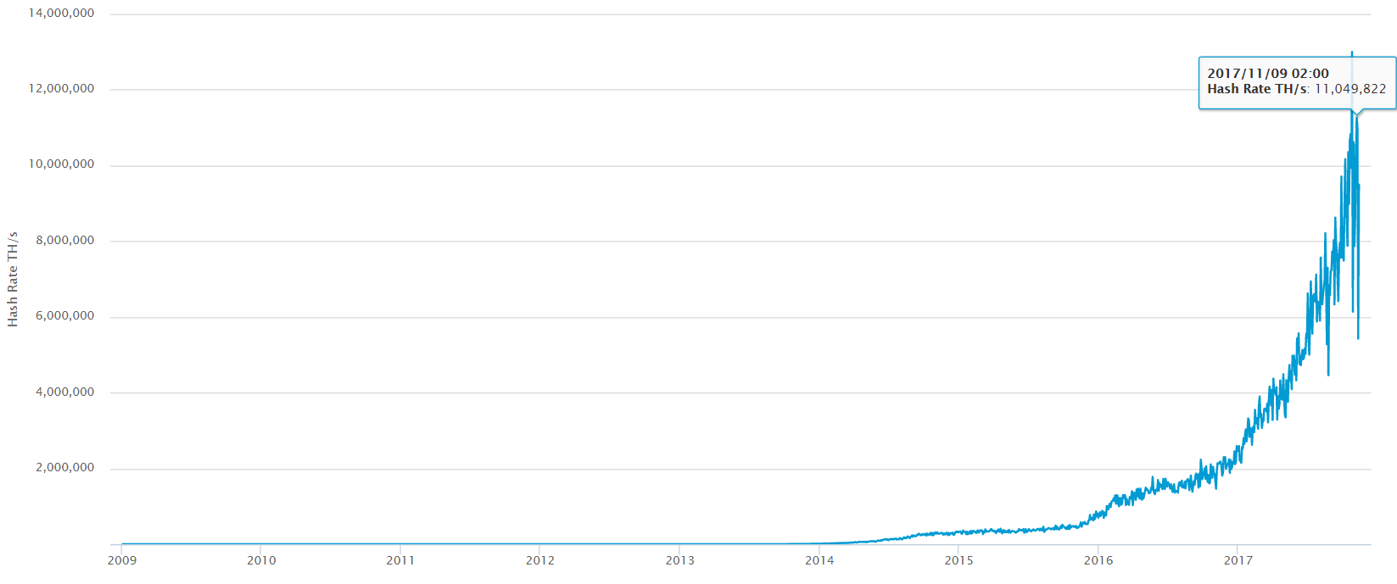
Intro and Motivation from single miners to mining pools
Source: https://blockchain.info/charts/hash-rate
Exponential growth of mining difficulty
Exponential growth of total hash rate – GPU, ASIC systems…
The protocol implies finding a new block every 10 minutes
The difficulty target is modified accordingly
Impractical for solo miners without updating their rig very often
From single miners to mining pools
Miners share their computational power to work together
Miners prefer a steady stream of small payments over periodic large payments
The pool manager - coordinates the activities of the miners
Miners can mine without running a full node
Don’t have to care about maintenance of software, updates etc..

Slide 3
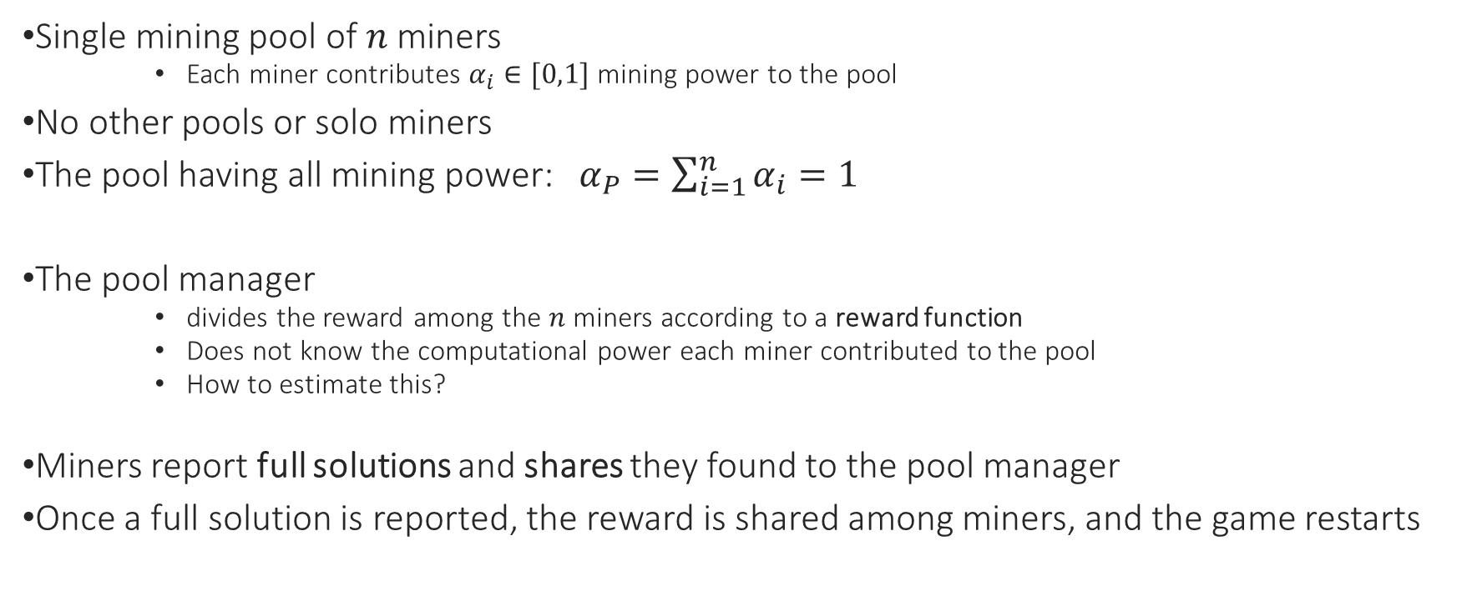
The model
Single mining pool of $n$ miners
Each miner contributes $α_{i}∈[0,1]$ mining power to the pool
No other pools or solo miners
The pool having all mining power: $α_{P}=\sum_{i=1}^{n}{α_{i}}=1$
The pool manager
divides the reward among the $n$ miners according to a reward function
Does not know the computational power each miner contributed to the pool
How to estimate this?
Miners report full solutions and shares they found to the pool manager
Once a full solution is reported, the reward is shared among miners, and the game restarts

Slide 4
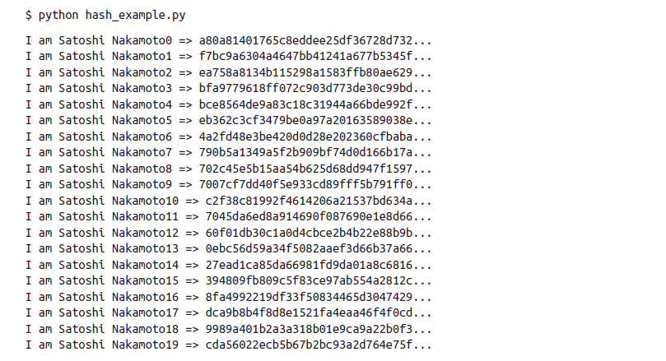

Shares vs. full solution
The SHA-256 hash function
Collision resistant
Uniform distribution - changing a single bit outputs a totally different hash value
The difficulty target – num. of leading zeros
A threshold value - we want to find values below it. (dice analogy)
Each extra zero, makes the difficulty grow exponentially
Proof of work – a way to measure the contribution of each miner (estimate $α_{i}$)
A share is a pool concept, does not have any value outside the pool
Source: Mastering Bitcoin, Andreas M. Antonopoulos

Slide 5
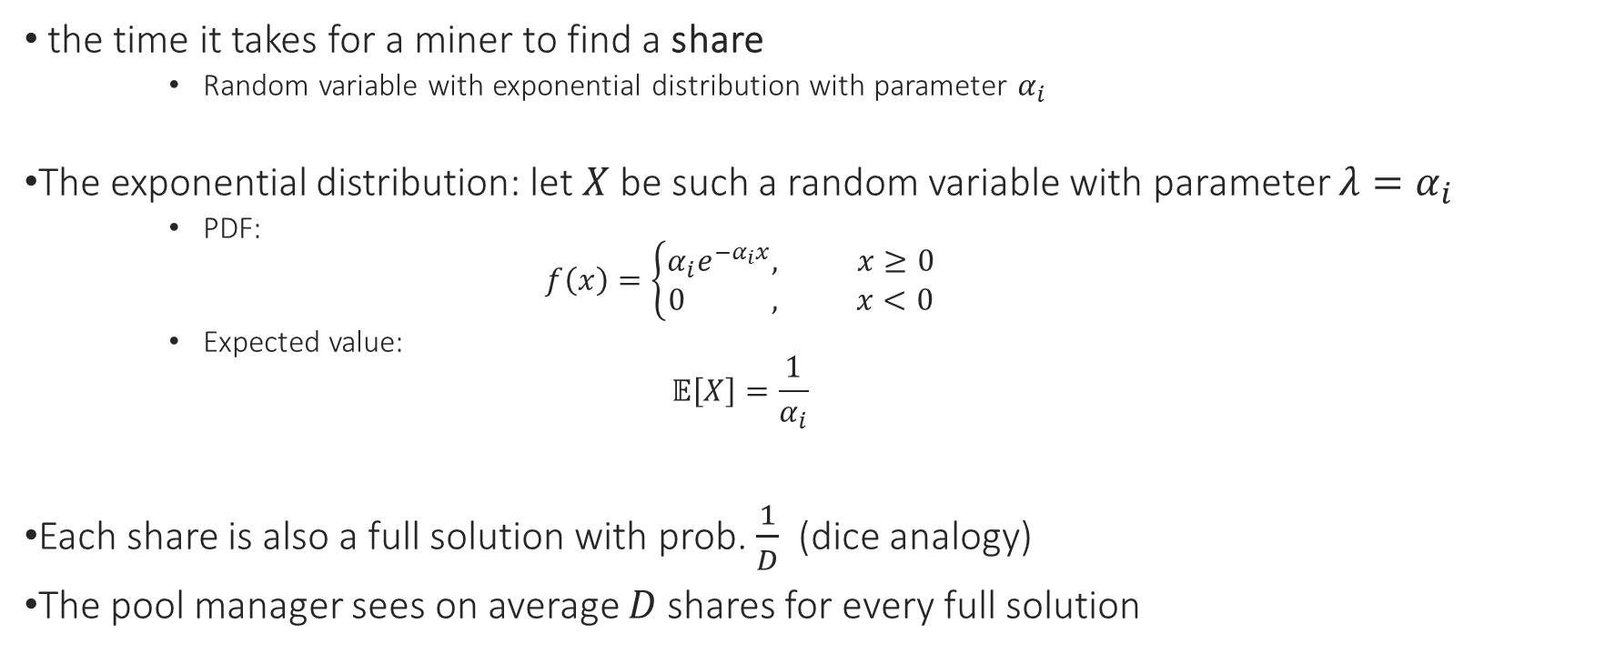
Exponential distribution
the time it takes for a miner to find a share
Random variable with exponential distribution with parameter $α_{i}$
The exponential distribution: let $X$ be such a random variable with parameter $λ=α_{i}$
PDF:
$$f\left(x\right)=\left\{\begin{aligned}α_{i}e^{−α_{i}x}, x≥0 \\ 0 , x<0\end{aligned}\right.$$
Expected value:
$$𝔼\left[X\right]=\frac{1}{α_{i}}$$
Each share is also a full solution with prob. $\frac{1}{D}$ (dice analogy)
The pool manager sees on average $D$ shares for every full solution

Slide 6
Miner’s view
Reward function - the only way in which miners get any payout
Miner’s dilemma (report immediately or wait)
Leading question:
if individual miners are interested in maximizing their expected utility, is their behavior optimal for the pool as a group?

Slide 7
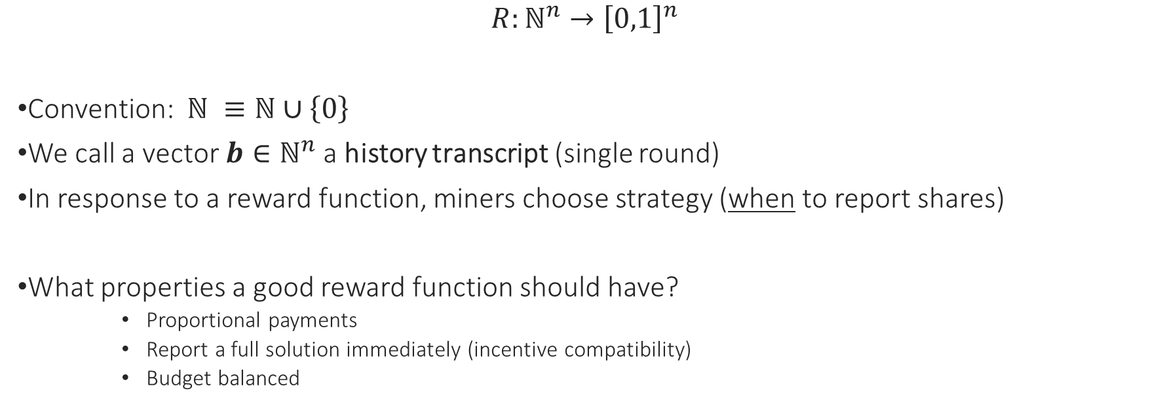
The reward function
$$R:ℕ^{n}→{\left[0,1\right]}^{n}$$
Convention: $ℕ ≡ℕ∪\left\{0\right\}$
We call a vector $b∈ℕ^{n}$ a history transcript (single round)
In response to a reward function, miners choose strategy (when to report shares)
What properties a good reward function should have?
Proportional payments
Report a full solution immediately (incentive compatibility)
Budget balanced

Slide 8
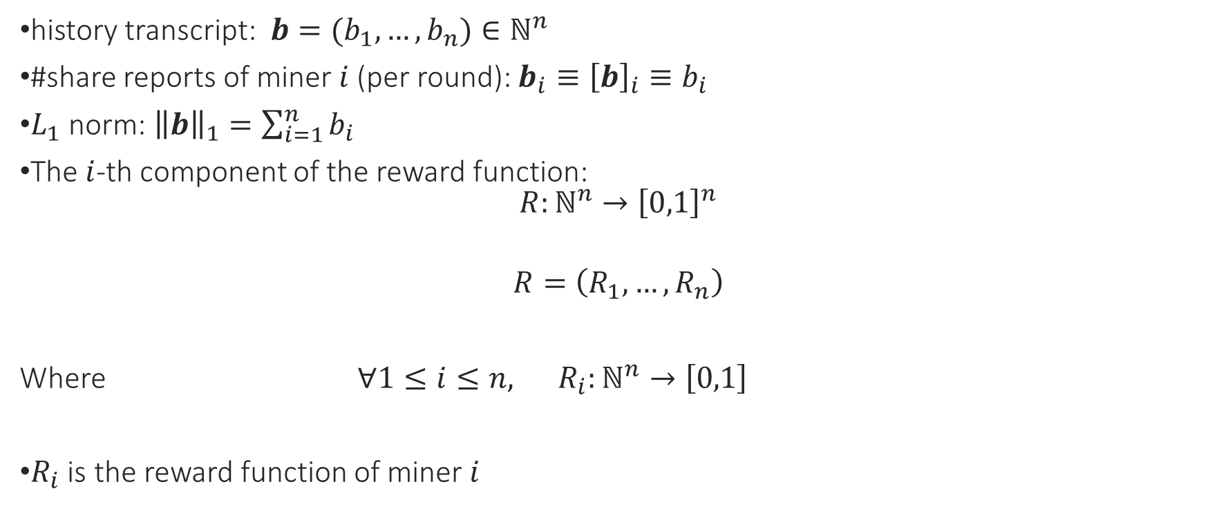
A word on notation
history transcript: $b=(b_{1},…,b_{n})∈ℕ^{n}$
#share reports of miner $i$ (per round): $b_{i}≡{\left[b\right]}_{i}≡b_{i}$
$L_{1}$ norm: ${\left\|b\right\|}_{1}=\sum_{i=1}^{n}{b_{i}}$
The $i$-th component of the reward function:
$$R:ℕ^{n}→{\left[0,1\right]}^{n}$$
$$R=\left(R_{1},…,R_{n}\right)$$
Where $∀1≤i≤n, R_{i}:ℕ^{n}→\left[0,1\right]$
$R_{i}$ is the reward function of miner $i$

Slide 9

Proportional payments (def.)
A reward function $R$provides proportional payments, if for each miner $i$:
$𝔼_{b}\left[R_{i}\left(b\right)\right]=α_{i}$
Expectation over all $b∈ℕ^{n}$

Slide 10

Incentive compatibility (def.)
A reward function $R$ is incentive compatible if for every miner, the best strategy (given this particular $R$) is to report full solutions immediately.

Slide 11
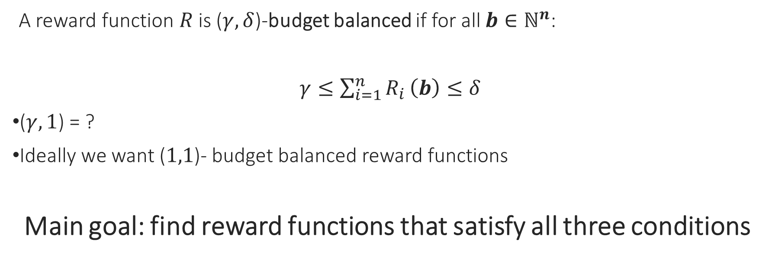
budget-balanced (def.)
A reward function $R$ is ($γ, δ$)-budget balanced if for all $b∈ℕ^{n}$:
$γ≤\sum_{i=1}^{n}{R_{i}}\left(b\right)≤δ$
($γ, 1$) = ?
Ideally we want ($1,1$)- budget balanced reward functions
Main goal: find reward functions that satisfy all three conditions

Slide 12
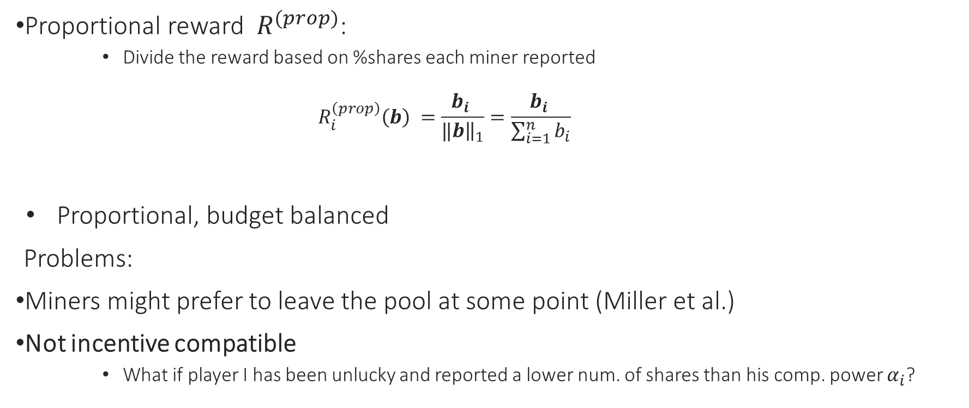
common reward functions
Proportional reward $R^{(prop)}$:
Divide the reward based on %shares each miner reported
$$R_{i}^{\left(prop\right)}\left(b\right) =\frac{b_{i} }{‖{\left.​b\right\|}_{1}}=\frac{b_{i} }{\sum_{i=1}^{n}{b_{i}}}$$
Proportional, budget balanced
Problems:
Miners might prefer to leave the pool at some point (Miller et al.)
Not incentive compatible
What if player I has been unlucky and reported a lower num. of shares than his comp. power $α_{i}$?

Slide 13

common reward functions
Pay-per-share $R^{(pps)}$
Pays a fixed amount for every share that is reported
$$R_{i}^{\left(pps\right)}\left(b\right) =\frac{b_{i} }{D}=b_{i}⋅\frac{1 }{D}$$

Slide 14
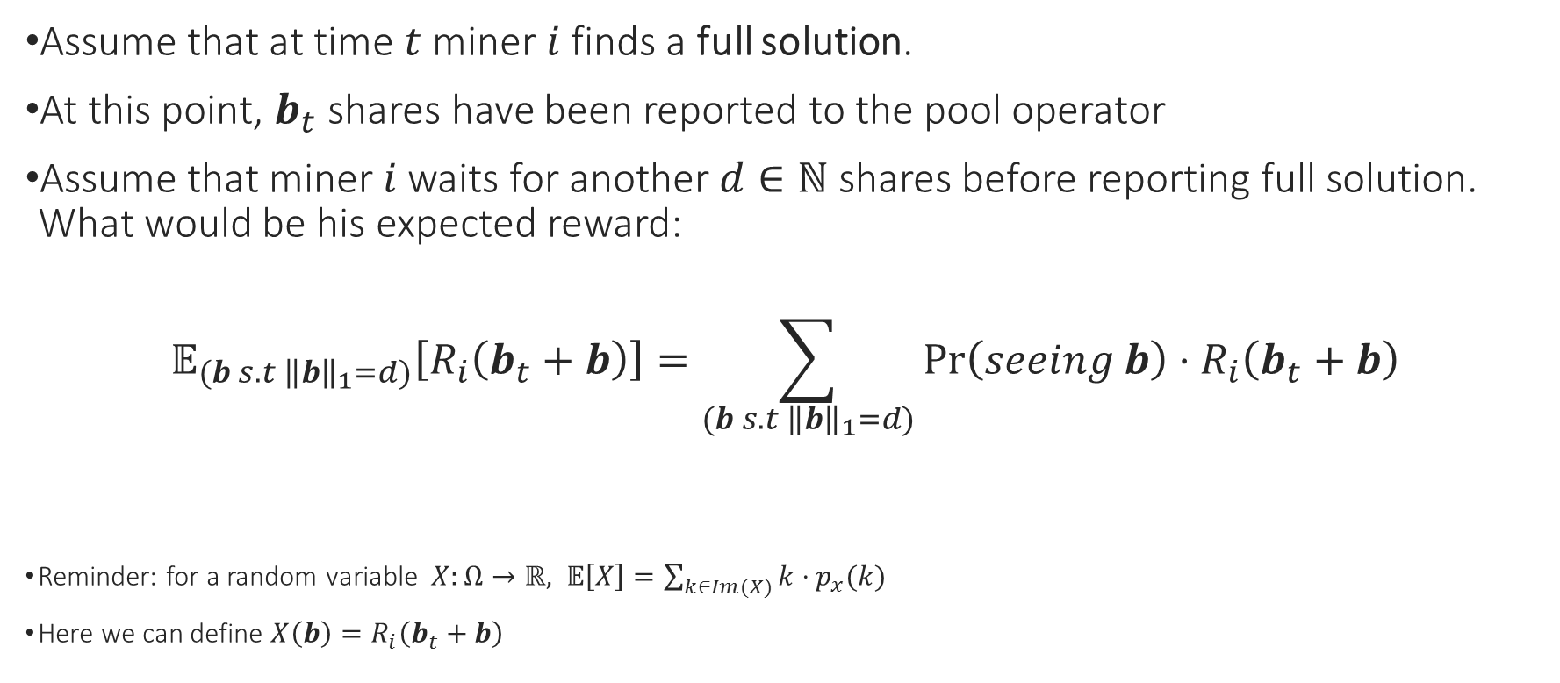
To delay or not to delay? Or: when would we prefer to report immediately
Assume that at time $t$ miner $i$ finds a full solution.
At this point, $b_{t}$ shares have been reported to the pool operator
Assume that miner $i$ waits for another $d∈ℕ$ shares before reporting full solution. What would be his expected reward:
$$𝔼_{(b s.t {\left\|b\right\|}_{1}=d)}\left[R_{i}\left(b_{t}+b\right)\right]=\sum_{(b s.t {\left\|b\right\|}_{1}=d)}{\operatorname{Pr}\left(seeing b\right)⋅R_{i}\left(b_{t}+b\right)}$$
Reminder: for a random variable $X:Ω→ℝ, 𝔼\left[X\right]=\sum_{k∈Im(X)}{k⋅p_{x}(k)}$
Here we can define $X\left(b\right)=R_{i}\left(b_{t}+b\right)$

Slide 15

To delay or not to delay? Or: when would we prefer to report immediately
If miner $i$ reports immediately (upon finding a full solution):
His reward will be:
$R_{i}\left(b_{t}\right)+d⋅\frac{𝔼_{b}\left[R_{i}\left(b\right)\right]}{𝔼_{b}\left[{\left\|b\right\|}_{1}\right]}=R_{i}\left(b\right)+d⋅\frac{𝔼_{b}\left[R_{i}\left(b\right)\right]}{\sum_{k=1}^{∞}{k{\left(1−\frac{1}{D}\right)}^{k−1}⋅\frac{1}{D}}}=$
$=R_{i}\left(b_{t}\right)+\frac{d}{D}⋅𝔼_{b}\left[R_{i}\left(b\right)\right]$

Slide 16

To delay or not to delay? Or: when would we prefer to report immediately
Overall, reporting a full solution immediately will be more profitable than delaying for $d$ shares iff:
$$\sum_{(b s.t {\left\|b\right\|}_{1}=d)}{\operatorname{Pr}\left(seeing b\right)⋅{(R}_{i}\left(b_{t}+b\right)−{(R}_{i}(b_{t}))≤\frac{d}{D}⋅𝔼_{b}\left[R_{i}\left(b\right)\right]}$$

Slide 17
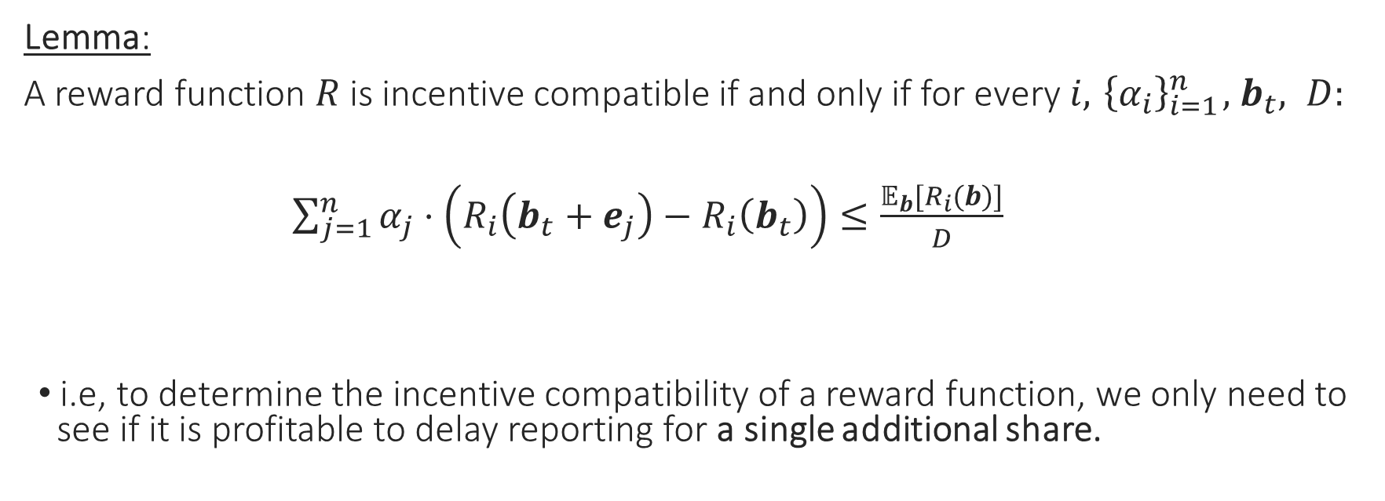
equiv. condition for incentive comp.
Lemma:
A reward function $R$ is incentive compatible if and only if for every $i, { \left\{α_{i}\right\}}_{i=1}^{n}, { b}_{t}, D:$
$\sum_{j=1}^{n}{α_{j}⋅\left(R_{i}\left(b_{t}+e_{j}\right)−R_{i}\left(b_{t}\right)\right)≤\frac{𝔼_{b}[R_{i}(b)]}{D}}$
i.e, to determine the incentive compatibility of a reward function, we only need to see if it is profitable to delay reporting for a single additional share.

Slide 18
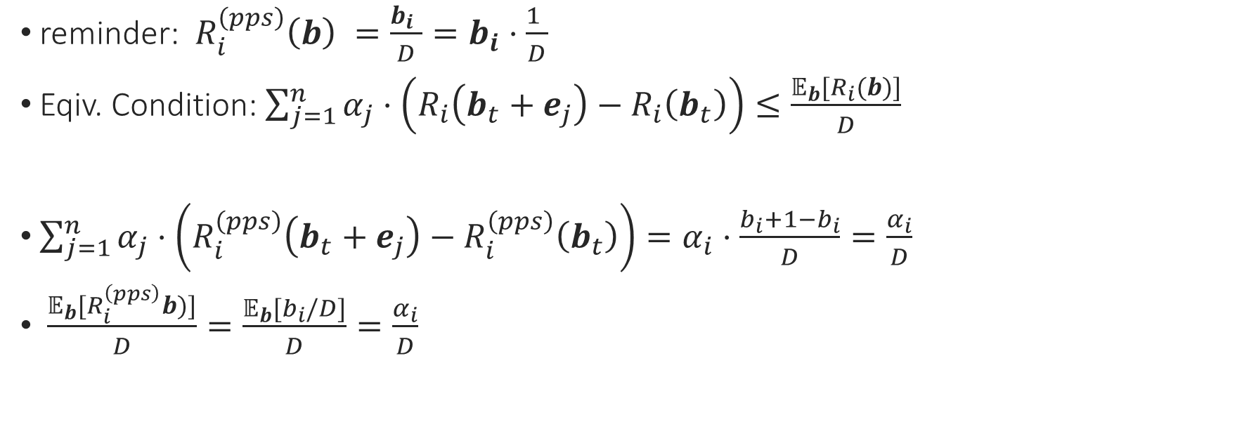
Pay-per-share is not incentive comp.
reminder: $R_{i}^{\left(pps\right)}\left(b\right) =\frac{b_{i} }{D}=b_{i}⋅\frac{1 }{D}$
Eqiv. Condition: $\sum_{j=1}^{n}{α_{j}⋅\left(R_{i}\left(b_{t}+e_{j}\right)−R_{i}\left(b_{t}\right)\right)≤\frac{𝔼_{b}[R_{i}(b)]}{D}}$
$\sum_{j=1}^{n}{α_{j}⋅\left(R_{i}^{\left(pps\right)}\left(b_{t}+e_{j}\right)−R_{i}^{\left(pps\right)}\left(b_{t}\right)\right)=α_{i}⋅\frac{b_{i}+1−b_{i}}{D}=\frac{α_{i}}{D}}$
$\frac{𝔼_{b}[R_{i}^{\left(pps\right)}b)]}{D}=\frac{𝔼_{b}[b_{i}/D]}{D}=\frac{α_{i}}{D}$

Slide 19
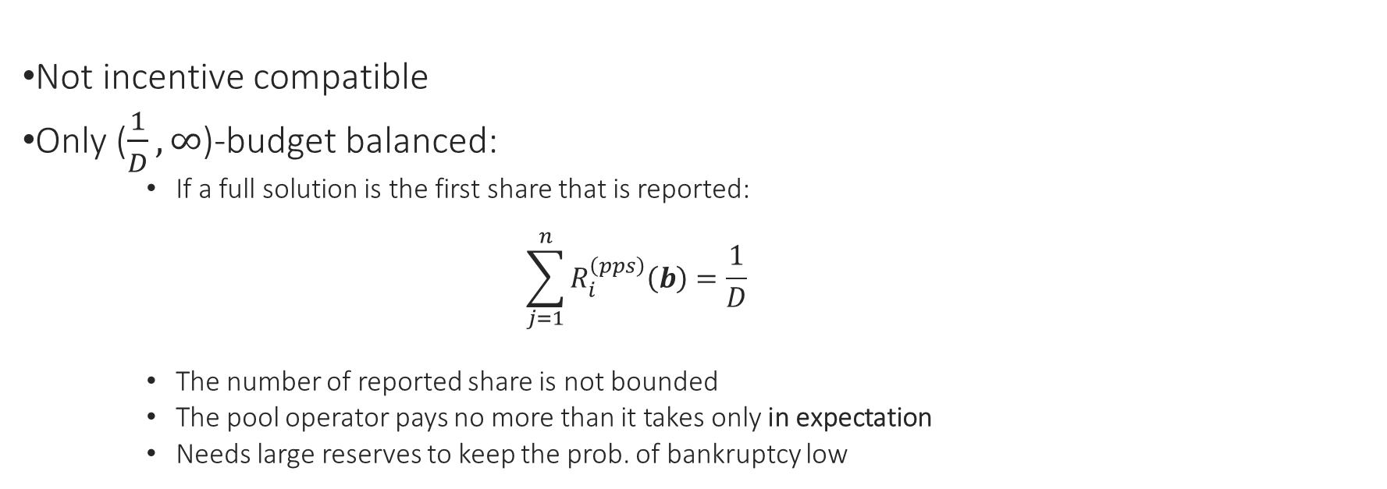

Problems with $R_{i}^{\left(pps\right)}$
Not incentive compatible
Only ($\frac{1}{D}, ∞$)-budget balanced:
If a full solution is the first share that is reported:
$$\sum_{j=1}^{n}{R_{i}^{\left(pps\right)}\left(b\right)=\frac{1}{D}}$$
The number of reported share is not bounded
The pool operator pays no more than it takes only in expectation
Needs large reserves to keep the prob. of bankruptcy low

Slide 20
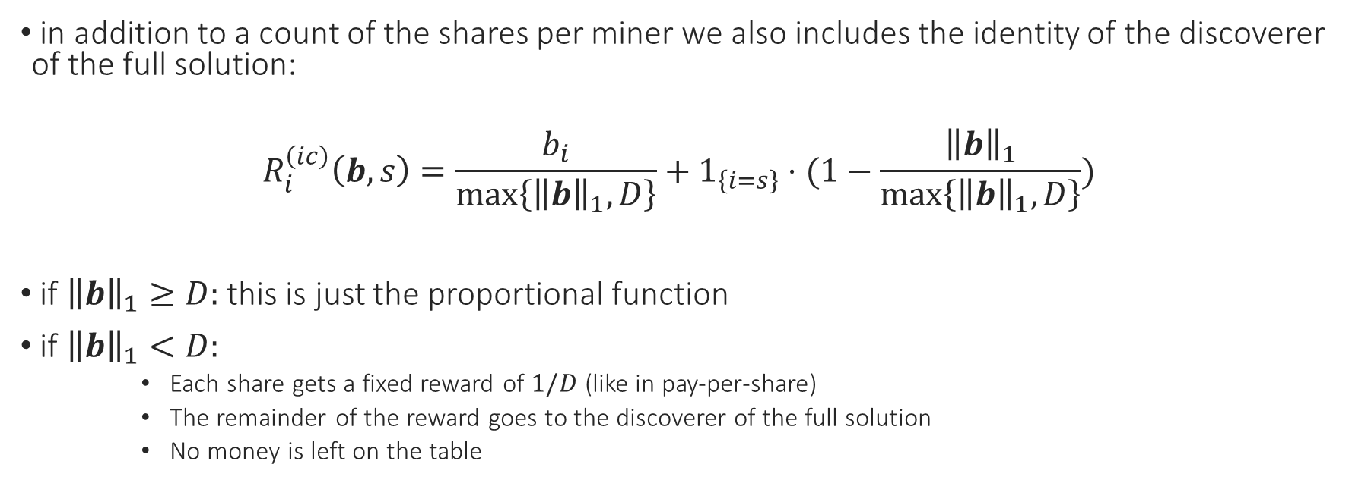
The IC Reward Function
in addition to a count of the shares per miner we also includes the identity of the discoverer of the full solution:
$$R_{i}^{\left(ic\right)}\left(b,s\right)=\frac{b_{i}}{\max\left\{{\left\|b\right\|}_{1}, D\right\}}+1_{\left\{i=s\right\}}⋅(1−\frac{{\left\|b\right\|}_{1}}{\max\left\{{\left\|b\right\|}_{1}, D\right\}})$$
if ${\left\|b\right\|}_{1}≥D:$ this is just the proportional function
if ${\left\|b\right\|}_{1}<D:$
Each share gets a fixed reward of $1/D$ (like in pay-per-share)
The remainder of the reward goes to the discoverer of the full solution
No money is left on the table

Slide 21

The IC Reward Function
${ R}^{(ic)}$ provides proportional payments
${ R}^{(ic)}$ is incentive compatible
${ R}^{(ic)}$ is ($1,1$)-budget balanced

Slide 22
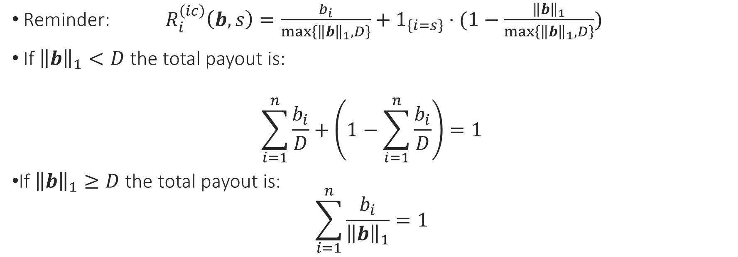

${ R}^{(ic)}$ is ($1,1$)-budget balanced:
Reminder: $R_{i}^{\left(ic\right)}\left(b,s\right)=\frac{b_{i}}{\max\left\{{\left\|b\right\|}_{1}, D\right\}}+1_{\left\{i=s\right\}}⋅(1−\frac{{\left\|b\right\|}_{1}}{\max\left\{{\left\|b\right\|}_{1}, D\right\}})$
If ${\left\|b\right\|}_{1}<D$ the total payout is:
$$\sum_{i=1}^{n}{\frac{b_{i}}{D}}+\left(1−\sum_{i=1}^{n}{\frac{b_{i}}{D}}\right)=1$$
If ${\left\|b\right\|}_{1}≥D$ the total payout is:
$$\sum_{i=1}^{n}{\frac{b_{i}}{{\left\|b\right\|}_{1}}=1}$$

Slide 23
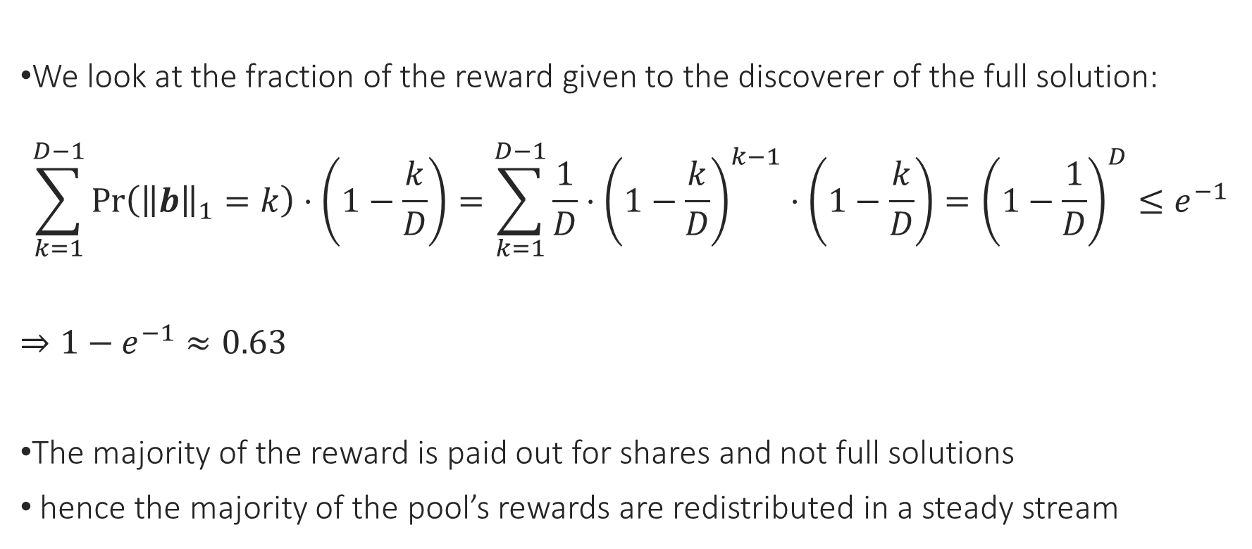

${ R}^{(ic)}$ provides a Steady Payment Stream
We look at the fraction of the reward given to the discoverer of the full solution:
$$\sum_{k=1}^{D−1}{\operatorname{Pr}\left({\left\|b\right\|}_{1}=k\right)⋅\left(1−\frac{k}{D}\right)=\sum_{k=1}^{D−1}{\frac{1}{D}⋅{\left(1−\frac{k}{D}\right)}^{k−1}⋅\left(1−\frac{k}{D}\right)={\left(1−\frac{1}{D}\right)}^{D}≤e^{−1}}}$$
$⇒1−e^{−1}≈0.63$
The majority of the reward is paid out for shares and not full solutions
hence the majority of the pool’s rewards are redistributed in a steady stream

Slide 24
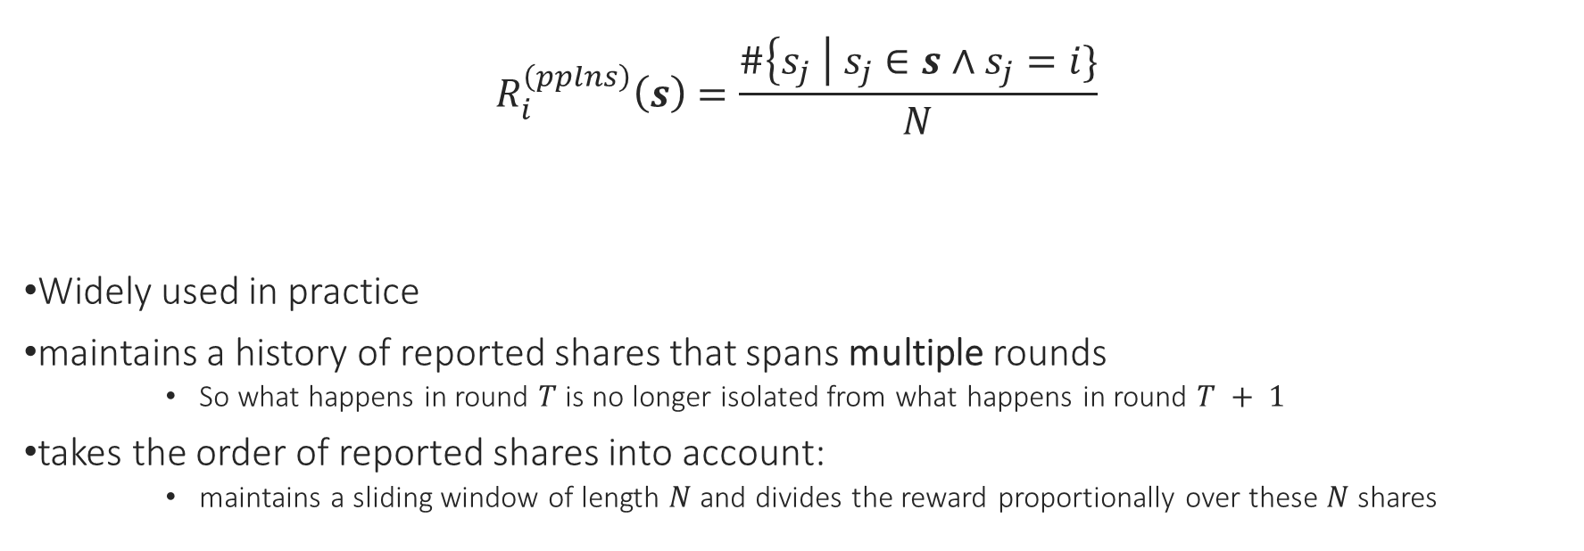
Pay-Per-Last-N-Shares (PPLNS)
$$R_{i}^{\left(pplns\right)}\left(s\right)=\frac{\#\left\{s_{j} \right| s_{j}∈s∧s_{j}=i\}}{N}$$
Widely used in practice
maintains a history of reported shares that spans multiple rounds
So what happens in round $T$ is no longer isolated from what happens in round $T + 1$
takes the order of reported shares into account:
maintains a sliding window of length $N$ and divides the reward proportionally over these $N$ shares

Slide 25

Comparison by simulation
the simulation goes as follows:
Assume 1000 miners, each with $α_{i}=0.001$
$D=1,000,000$
Reward for a full solution is normalized to 1 BTC
A unit of time – a time to find a full solution (10 min)
We look at the most unluckiest miners (1% of miners) – how long they have to wait for a given amount

Slide 26
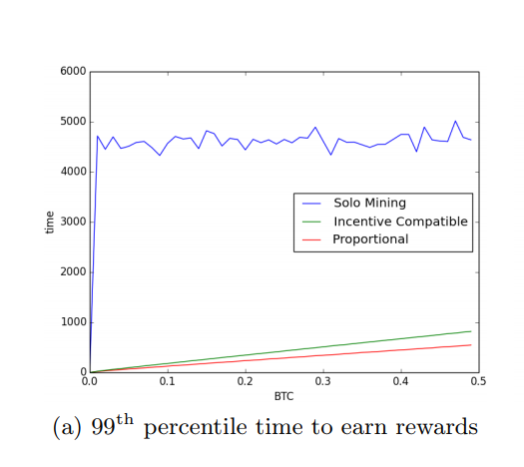
Comparison by simulation
Even though in expectation a solo miner finds a solution once in 1000 rounds, in the worst 1% of cases he has to wait 4500 rounds
incentive compatible scheme takes a bit longer to reach the same target than the proportional scheme – not all reward is shared according to reported shares
The difference is up to a small factor

Slide 27
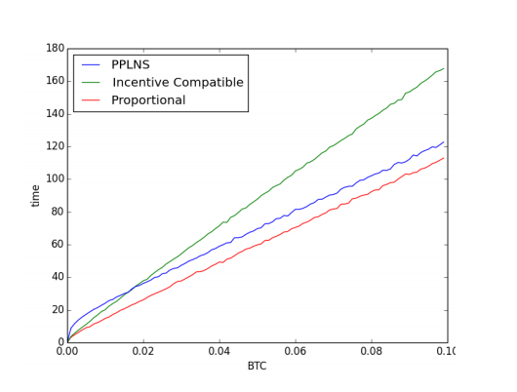
Comparison with PPLNS
the incentive compatible (IC) scheme performs worse by a small multiplicative factor
the PPLNS scheme performs worse by a small additive factor
for small Bitcoin targets it would be faster to use the IC reward function, whereas for larger target the PPLNS reward function performs better

Slide 28
Conclusion
Tradeoff of using PPLNS or IC to proportional reward:
Using IC or PPLNS we pay with a modest delay in the time it would take miners to reach a minimal amount of bitcoin with high probability
But in return we get a scheme in which it is obvious for miners what the most profitable strategy for them is

Slide 29

Thank you!
Source: http://coinalert.eu/maxthumb/20160922044332.jpg

